Slide 2
Budget Center
Vicki Cooley
Data Analyst, Budget Office

Slide 3

Budget Center
Introductions
  Name, department, role at university
  Do you use Cognos currently?
  Is there anything specific you hope to get out of training?

Slide 4
Budget Office
Who we are:
Budget Office Team
Arianne Anderson - Budget Analyst
Vicki Cooley – Data Analyst
Niki White – Assistant Director

Slide 5
Budget Center
Cognos reports and dashboards
Features:
  Historical data back to 2015
  Operating and Payroll data for all funds
  Foundation data from Agresso
  Ability to export data to Excel
  Ability to set up report subscriptions
  Dashboards/charts
Ongoing training sessions offered – registration link on Budget.illinoisstate.edu

Slide 6
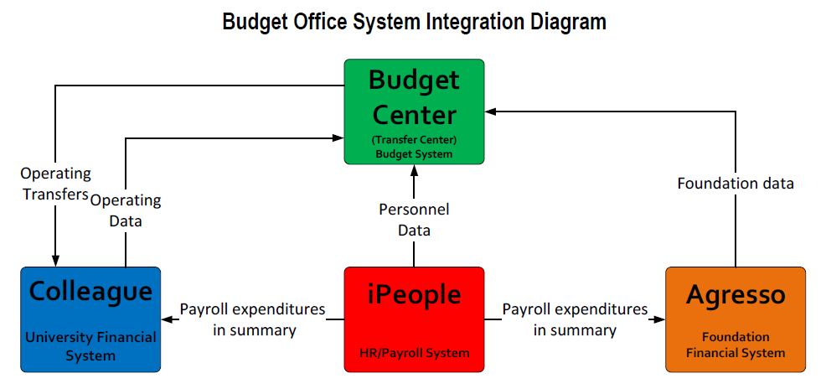
Budget Center
*All data refreshed nightly
Detailed integration diagram

Slide 7
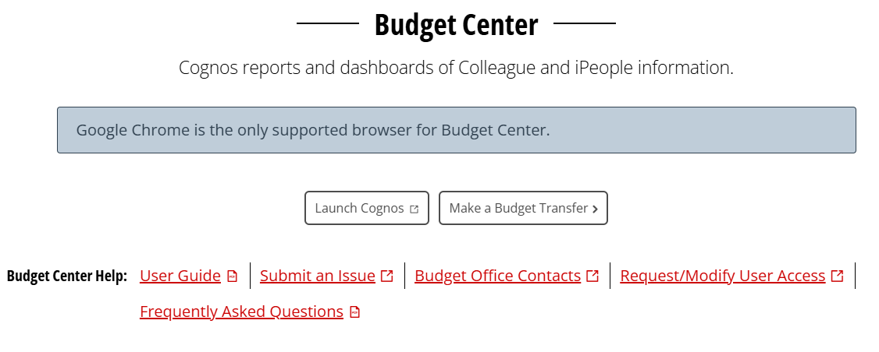
Budget Center Access
NOTE: If off-campus, must be logged in to VPN. Use Google Chrome.
Access via My Illinois State → Fiscal Tab
OR
Can access directly at: https://insight.illinoisstate.edu/
OR
Budget Office homepage: http://www.budget.illinoisstate.edu

Slide 8
Budget Center
Demo Reports
  GR top level
    Operating budget/exp/enc/available
    Personnel budget/exp/enc/available
  GR All Details
    Go through each tab
    Show download to Excel
  GR Unit Total Summary
  Budget Transfer Details
  Agency All Details (if applicable)
    Show cash balance
  Grants – expenditures by date range (if applicable)
  Employee Position Funding (next slides)

Slide 9
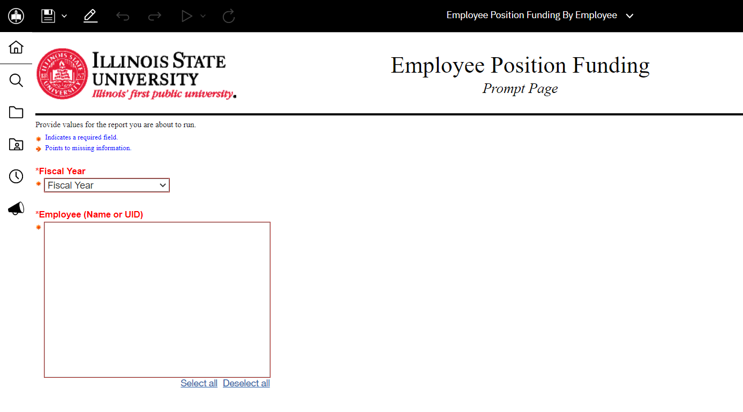

Slide 10
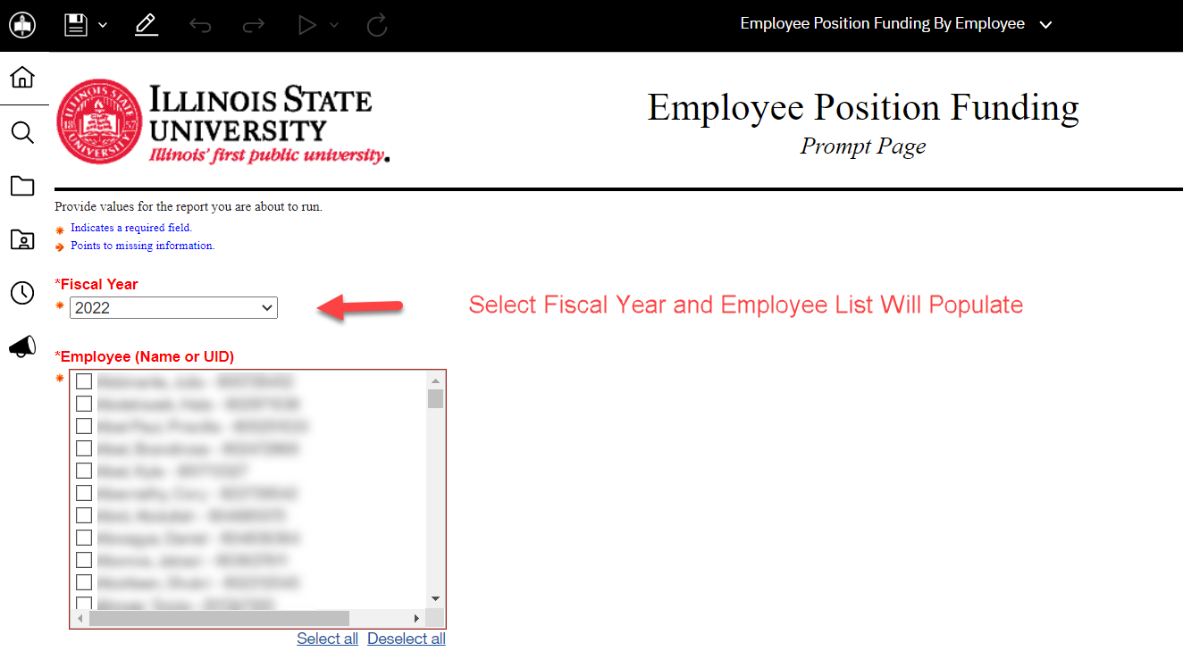

Slide 11
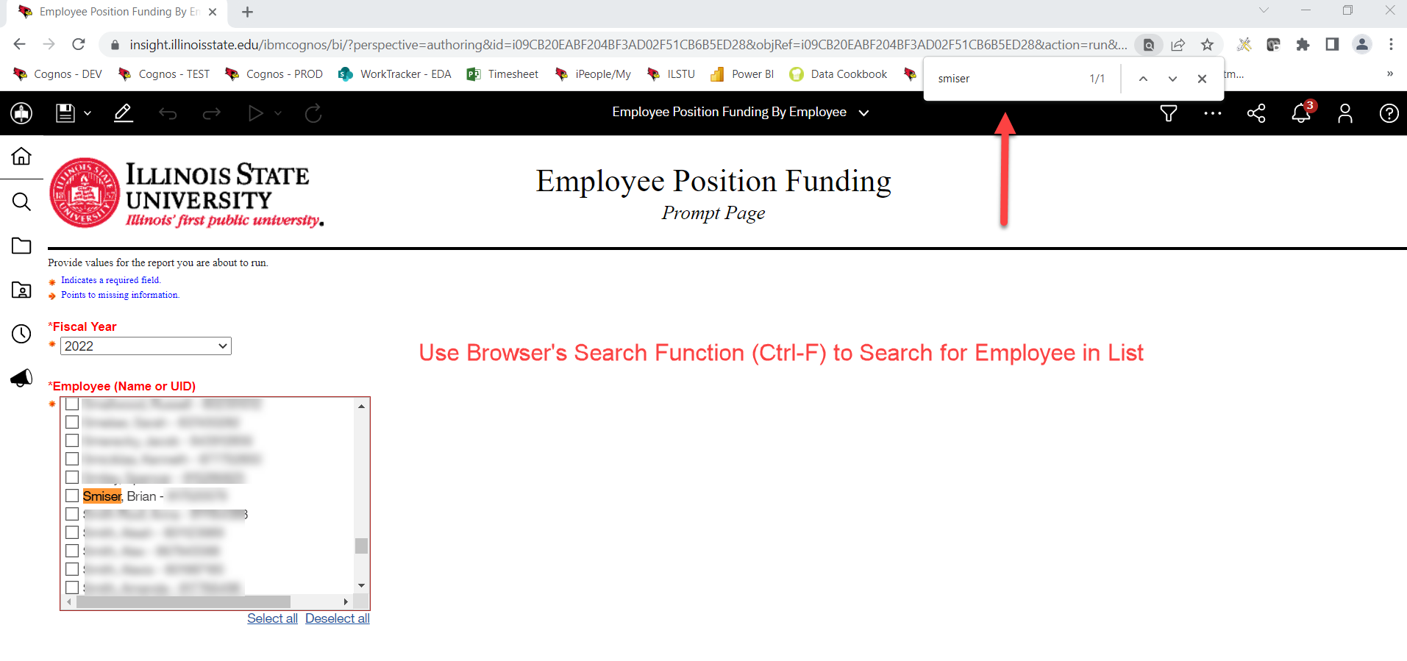

Slide 12
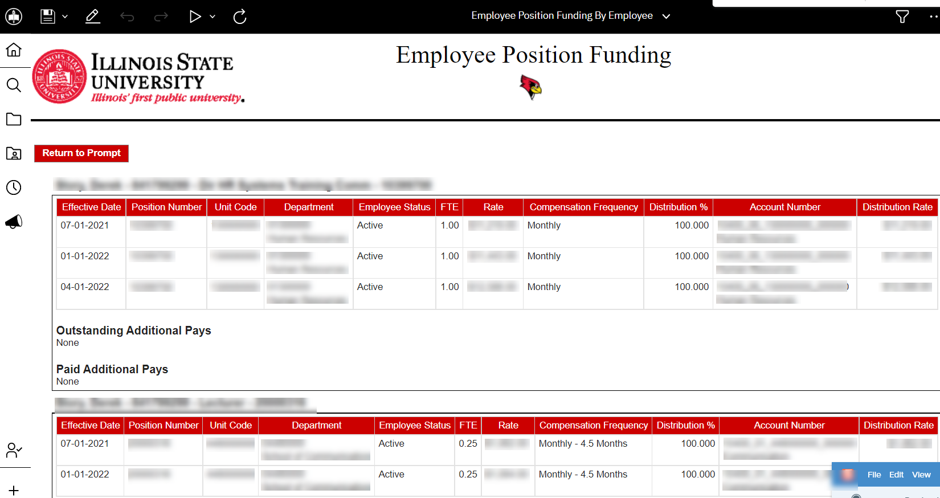
Primary position department users will see primary and secondary positions.
Secondary position department users will see only secondary position.

Slide 13
Budget Center
Demo dashboards
Demo Technology (some will be repetitive)
  News & Alerts
  Run Button
  Reggie head
  Report subscriptions
  Control F
  Sorting within reports
Demo Transfer Center (if applicable)

Slide 14

Budget Center Tips
If off-campus, must connect to VPN
Must use Google Chrome
When downloading to Excel, Use “Run Excel”
Use Ctrl + F to find a specific unit, name, etc.
Use “Reset dashboard” button to reset dashboard filters

Slide 15
Contacts and Resources
Budget Office
  Email: UniversityBudgetOffice@ilstu.edu
  Website: Budget.illinoisstate.edu
Budget/Transfer Center User's Guide
Frequently Asked Questions
Cognos Resources and Budget Center report information
Monthly Cognos newsletters will be sent by Enterprise Data & Analytics (EDA)

Slide 16

Questions

